Slide 1
A1 Chemistry
covalent molecular bonding

Slide 2
Which technique would be most appropriate for separating…
sand from salt?
salt from water?
eucalyptus oil from crushed leaves?
pigments from berry juice?
Draw an ionic lattice and explain why ionic compounds have such high melting and boiling points but such low density.

Slide 3
Learning intentions
molecular structural formulae (condensed or showing bonds) can be used to show the arrangement of atoms and bonding in covalent molecular substances
the properties of covalent molecular substances, including low melting point, can be explained by their structure and the weak intermolecular forces between molecules; their non-conductivity in the solid and liquid/molten states can be explained by the absence of mobile charged particles in their molecular structure

Slide 4
Success criteria
Draw a diagram to show the arrangement of particles in covalent substances
List the properties of covalent substances
Use the arrangement of covalent particles to explain their physical properties

Slide 5
key words
covalent
molecular
structural formula
intramolecular
intermolecular

Slide 6
covalent bonding
forms between two or more atoms which have high electronegativity (relatively full shells and tightly held electrons)
ie non-metals

Slide 7
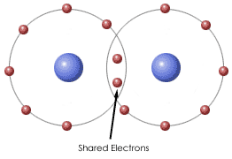
covalent bonds
In order to achieve full outer shells, atoms share valence electrons by overlapping their outer shells
A shared pair of electrons make up a single bond
Atoms which need more electrons may form double bonds (two shared pairs) or even triple bonds (three shared pairs) or may bond with several atoms

Slide 8
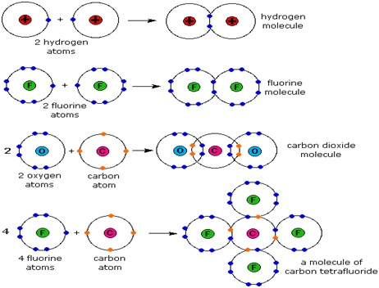

Slide 9


Slide 10
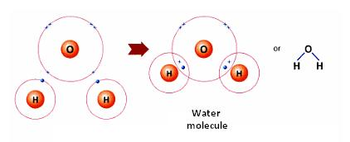
covalent molecules
Molecules are discrete groups of atoms which are covalently bonded together in fixed numbers of atoms
Molecular formula may be expanded to show the bonding arrangement, using lines or dot diagrams to represent bonds

Slide 11


Slide 12
properties of covalent molecular compounds
Molecules are held together by strong covalent bonds within themselves, (intramolecular),
but the molecules are bonded weakly to each other by other kinds of forces (intermolecular)
The properties of molecular compounds are determined by these weak intermolecular forces, not the covalent bonds themselves

Slide 13
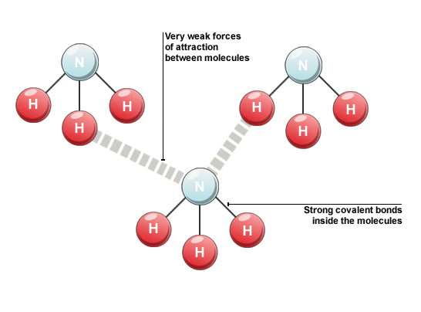

Slide 14
covalent molecular substances
Relatively low melting and boiling points (many are gases at room temperature)
This tends to increase as the molecules get bigger
As solids, they are soft and waxy
Non-conductors in all states – electrons are tightly held and the molecules themselves are uncharged

Slide 15
Do now…
Question set 3.5

Slide 16
Success criteria
Draw a diagram to show the arrangement of particles in covalent substances
List the properties of covalent substances
Use the arrangement of covalent particles to explain their physical properties

